Slide 1
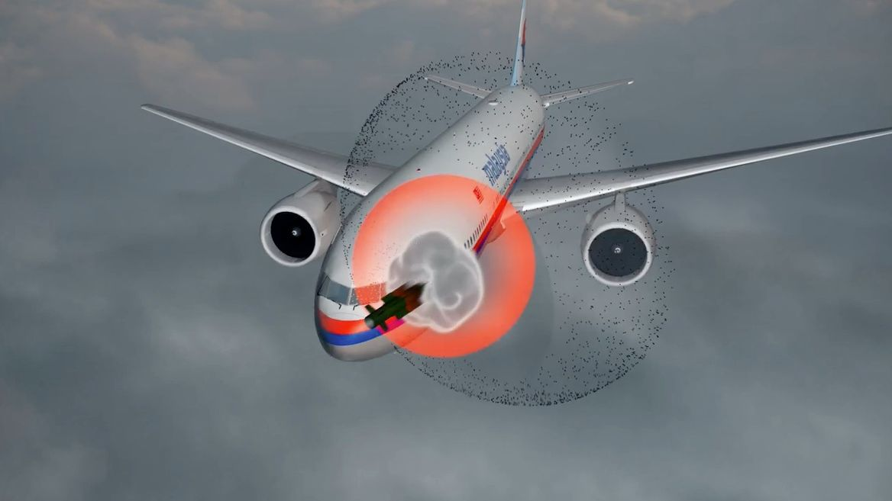


CLUSTERING
PREDICTION
IDENTIFY INTENTION
SHOOT TARGET
CLUSTERING OF AIR OBJECTS
BASED ON TRAJECTORY
Smart India Hackathon

Slide 2
TEAM MEMBERS
SANSKRITI TIWARI
MUNEES KHAN
ROHIT PATHAK
SHUBHI VIJAYVERGIYA
SANKALP PATEL
SURYANSH TRIVEDI
ORGANIZATION : DTE OF IT & CYBER SECURITY, DRDO
DOMAIN BUCKET : SECURITY & SURVEILLANCE
TEAM NAME : CLUSTER CHAMPS
TEAM LEADER : SANSKRITI TIWARI

Slide 3
Problem Statement Description
15
min
The position of an object in the air can be indicated by latitude, longitude and altitude for a given time. A trajectory is a stream of such quadruples (time, latitude, longitude and altitude). Given a large set of such trajectories, without any other information, problem is to cluster them into meaningful objects such as Helicopter, Fighter/civilian Aircraft, UAV, Cruise Missile, dropped bomb, etc. An optimal scalable solution is desired using open source tools. Design a system to estimate location of flying object based on its trajectory, provide guidance to missile to shoot them depending on their location when missile will meet the object on its trajectory.
Click on the model to interact

Slide 4
Approach
Raw Data
Feature Selection
Cleaning
Clustering
Taking segment of trajectory of particular object
Training LSTM Model
Generating a predicted Trajectory graph
Comparing trajectory of object detected and given missile
Finding the collision point
Giving the guideline for shoot
Click on the model to interact

Slide 5
Student Innovation
Encoder and Decoder LSTM :
The model, used to predict the trajectory of the object integrates two modules :
An encoder LSTM to embed flight plans into a fixed size feature vector and
A decoder LSTM that maps the fixed size feature vector to target the flight trajectory sequence.

Slide 6
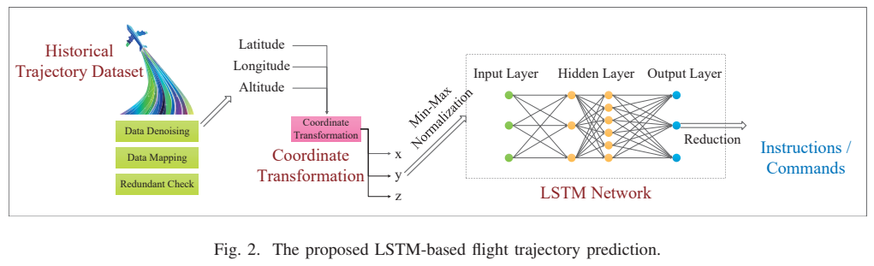
Encoder and Decoder LSTM

Slide 7
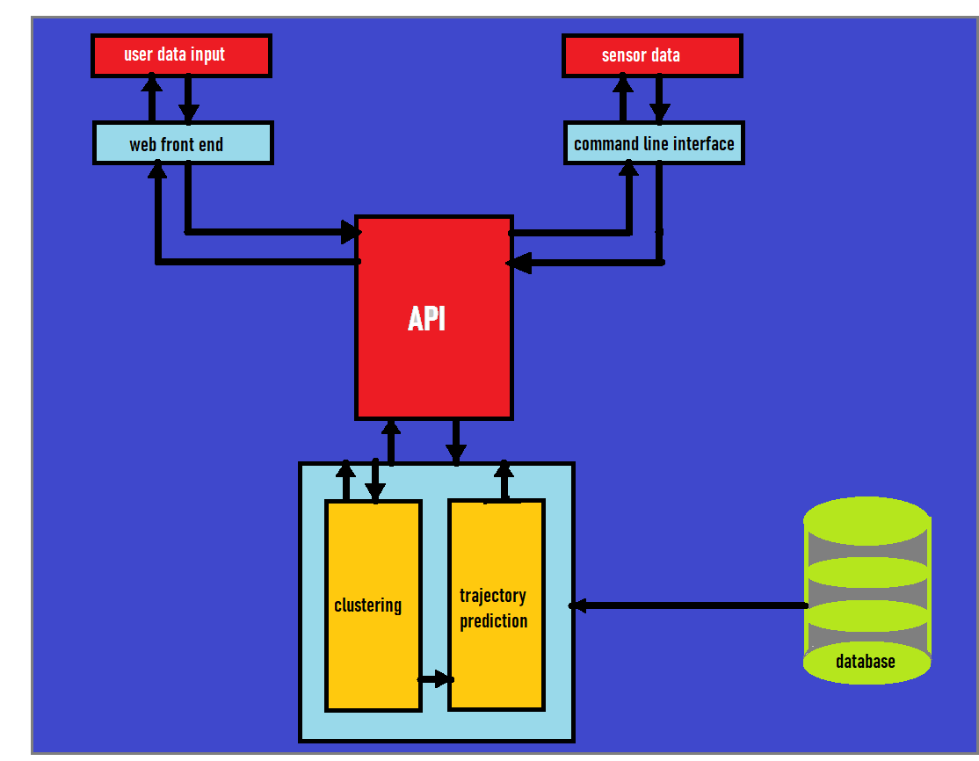
Software Flow
15
min
Click on the model to interact

Slide 8
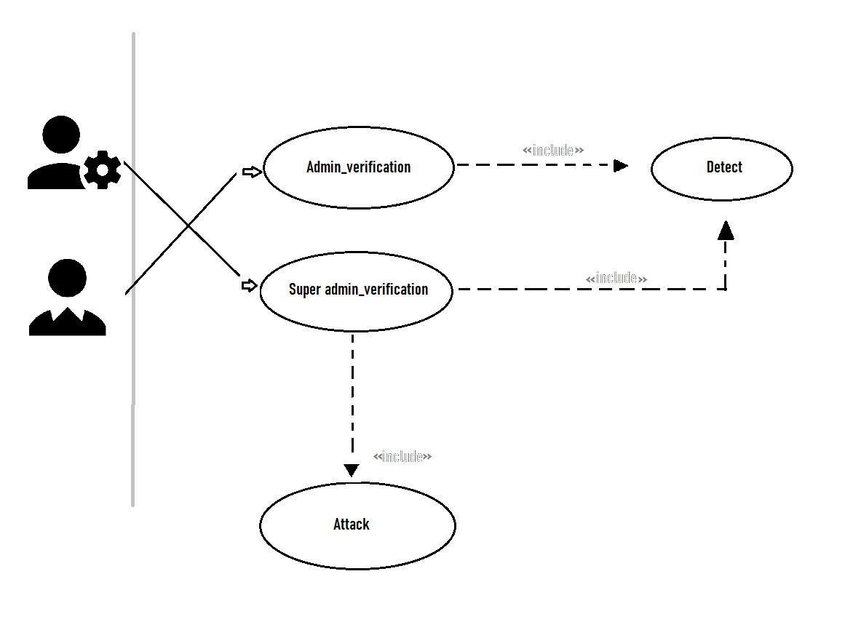
Use Case
15
min
Click on the model to interact

Slide 9
Dependencies and Show Stopper
15
min
Dependencies include access to the classified data such as data of all the flying object in INDIA (latitude, longitude, altitude and time).
Show stopper - The dataset for training a model has not been provided in the description of the problem statement so we are unable to proceed forward. As of the theoretical part we are ready.
Click on the model to interact

Slide 10






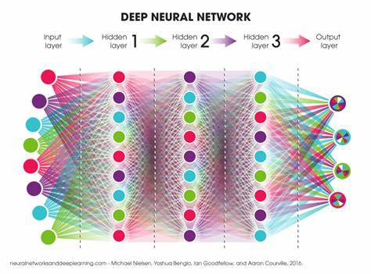

Technology Stack / Tool Selection

Slide 11


ANIMATED MODEL

Slide 12






Slide 13

Thanks for viewing our presentation
On
CLUSTERING OF AIR OBJECTS BASED ON TRAJECTORY

